Slide 1
Object Oriented Programming: Branching-1
Credit to: Lionov WLN

Slide 2
Intro
One of the essential features of computer programs is their ability to make decisions.
Like a train that changes tracks depending on how the switches are set, a program can take different actions depending on inputs and other circumstances.

Slide 3
Intro (2)
Example:
The university bookstore has a Kilobyte Day sale every October 24, giving an 8 percent discount on all computer accessory purchases if the price is less than $128, and a 16 percent discount if the price is at least $128. Write a program that asks the cashier for the original price and then prints the discounted price.

Slide 4
Intro(3)
Solution:
Check whether a condition is true or false (using relational & logical expressions)→ Is the price less than $128? (the answer is true or false)
Decide to choose only an alternative to be done and ignore any other alternative(s): branching.

Slide 5
Relational Operator
In order to make a decision, computer needs to know a condition that makes an alternative is chosen.
In many cases, the condition involves comparing values.
A relational operator tests the relationship between two values.
A relational expressions is an expression using relational operator, the result of this expression is a boolean value.

Slide 6
Relational Operator
Relational Operator
Java | Math Notation | Description
> | > | Greater than
>= | ≥ | Greater than or equal
< | < | Less than
<= | ≤ | Less than or equal
== | = | Equal
!= | ≠ | Not equal

Slide 7
Relational Operator
Example in Codepad
int a=10, b=20, c=30, d=40, e=50;
a==b
a!=b
a<b
c>d
d>=a
a<=b
(a+b)*c<(b-c)*d
(a-b)*3==7
(a+b)*(a*c)!=e*d

Slide 8
Logical Expressions
Logical/boolean value: TRUE or FALSE
Logical Expression: an arrangement of identifier, literal (TRUE or FALSE), logical operators and/or relational expressions that can be evaluated to compute a logical value

Slide 9
Logical Operator
Logical operator takes logical expressions as operands
Logical operator in Java : && (AND), || (OR) & ! (NOT)
A (expr) | B (expr) | A && B | A || B | !A | !B
False | False | False | False | True | True
False | True | False | True | True | False
True | False | False | True | False | True
True | True | True | True | False | False

Slide 10
Logical Operator
Example in Codepad
boolean a= true, b=false, c=true; a&&b b&&c a||b !a||!b !a||b (a&&b)||(!b&&c) (!a||!b)&&(a||!b)||(b&&a&&!c) !(a&&b) b&&!a !b&&(b||(a&&!c))

Slide 11
Logical Operator
Exercise: what are the values of these expressions?
int pH=100, humidity=19; (pH==100)&&(humidity<20) (pH*humidity>pH/humidity)&&(humidity%2==0) (pH!=0)&&(humidity>19) (pH*0<0)&&(humidity*-1>=0) (pH*0<0)||!(humidity*-1>=0) (pH/pH!=1)||(humidity/pH>0) (pH/pH!=1)||(humidity/pH>=0)

Slide 12
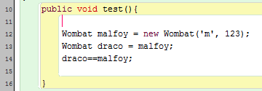
Logical Operator
How does == work on object references?
Wombat malfoy =
'm'
123
Wombat draco =

Slide 13
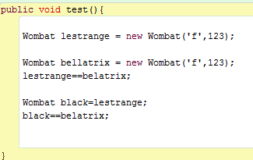
Logical Operator
How does == work on object references?
'f‘
123
Wombat lestrange =
'f‘
123
Wombat bellatrix =
Wombat
black=

Slide 14
Branching
Sequential control structure: computer executes each statements one after another
Conditional control structure: allow computer to choose between (two) alternative executions
Use a condition/boolean expression: a statement (logical expression) that is either true or false
Java uses if, if-else, multiway-if-else and/or switch statements with an assertion to alter the flow of the program and create conditional control structure

Slide 15
If statement
The if statement is used to implement a decision
When a condition is fulfilled, one set of statements is executed
Syntax:
if(condition) statement;

Slide 16
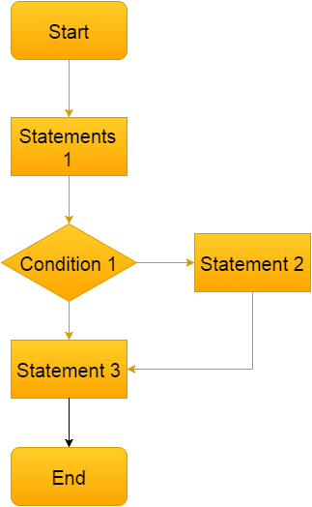
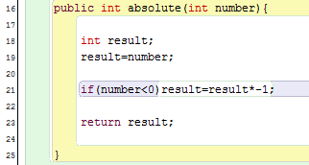
If statement

Slide 17
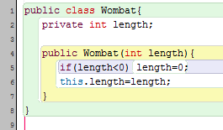
If Statement
If Statement example
The length is converted to 0 only if length < 0

Slide 18
Block Statements
Compound/Block Statement: A list of statements enclosed in a pair of braces.
Java treats compound statement as a single statement
It is very useful to be used with different control structure
Syntax of if statement using block statements:
if (conditions){ statement(s); }

Slide 19
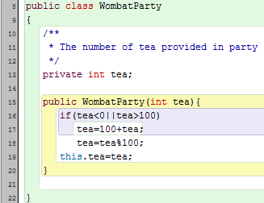
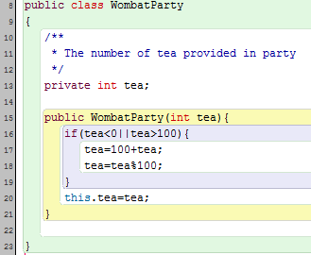
Block Statements
Can you determine the differences between these codes?

Slide 20
The if...else...Statement
The if-else statement chooses between two alternatives statements
Syntax:
if(expressions){ statement(s) A } else{ statement(s) B }

Slide 21
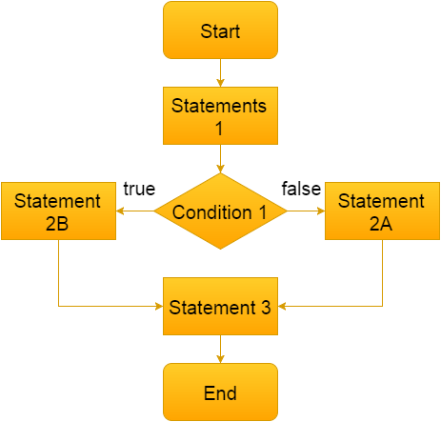
The if...else...Statement

Slide 22
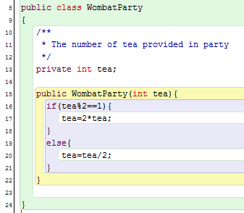
The if...else...Statement

Slide 23
Conditional Operator
Conditional operator: ternary operator or arithmetic if
Takes three operand
Syntax:
if Expression1 is TRUE then the computer will execute Expression2, but if Expression1 is FALSE then the computer will execute Expression3
Expression1? Expression2: Expression3

Slide 24
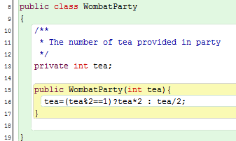
Conditional Operator
Conditional operator example

Slide 25
Exercise
Buatlah sebuah method untuk memeriksa apakah sebuah huruf kecil adalah huruf vokal/konsonan!
Buatlah sebuah method di dalam kelas Lingkaran untuk memeriksa apakah sebuah lingkaran lebih besar luasnya dibandingkan dengan lingkaran lainnya!
Buatlah sebuah kelas dengan nama Lampu! Kelas ini memiliki atribut bernama on (menyatakan apakah lampu menyala/tidak) dengan tipe data boolean. Buatlah method dengan nama switch. Method ini tidak memiliki parameter, dan berfungsi mematikan lampu jika lampu dalam keadaan menyala, dan menyalakan lampu jika lampu dalam keadaan mati.
Buatlah sebuah method untuk mendapatkan bilangan paling besar di antara dua buah bilangan bulat! Dengan method tersebut, buatlah method lain yang dapat mencari bilangan terbesar di antara 3 buah bilangan!

